Slide 1


Assessing your own courses
What approach works best for you?
David Mulford – Academic Technology Manager
Campbell University Information Technology Services

Slide 2
Remember your first week of teaching?
How well were you prepared?
What surprised you?
What encouraged you?
What fears came true?

Slide 3
How does Campbell measure teaching effectiveness?
Self Evaluations (focus for today)
Professional Performance Record (PPR) / University Effectiveness Council
Student Evaluations
Environmental Evaluations
Interviews with Deans and Chairs

Slide 4
Annual PPR related to Teaching activity
A) List by department, session, number, name, and enrollment of all courses taught.
B) List any significant changes or innovations in teaching from the previous review cycle and evaluate their effectiveness. Such matters may include use of technology, textbooks, instructional procedures, etc.
C) Provide a summary evaluation of your teaching effectiveness, with careful attention to both strengths and weaknesses.

Slide 5
How do YOU measure teaching effectiveness?
What does “effective course teaching” mean to you?
How would your students define effective teaching?
What does Teaching Effectiveness mean to you? To your colleagues?
What is considered an innovative or a significant change to your teaching?

Slide 6
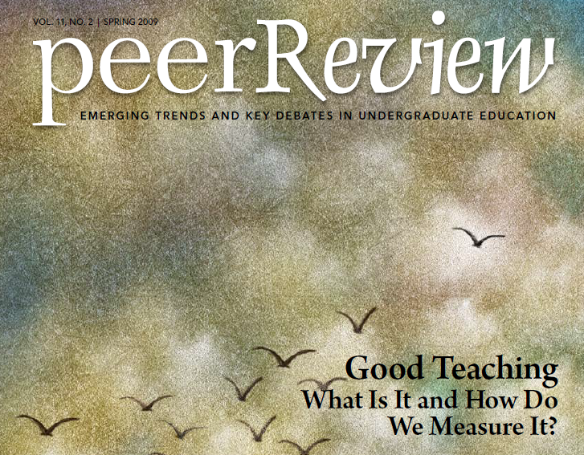
Sounds reasonable, but is effective teaching the same as good teaching?

Slide 7
And just what is “good” teaching anyway?

Slide 8
Self-evaluating teaching
(with a little help from ChatGPT)
1. Student feedback: Faculty can gather feedback from students through anonymous surveys at the end of the semester. This can provide insights into what students found helpful or challenging during the course, and how faculty may improve their teaching.
2. Peer observation: Inviting colleagues to observe classroom sessions and provide constructive feedback can help faculty identify areas of improvement in their teaching.
3. Self-reflection: Faculty can reflect on their teaching by reviewing course materials, lectures, and assignments to identify strengths and weaknesses. This can help identify areas for improvement.

Slide 9
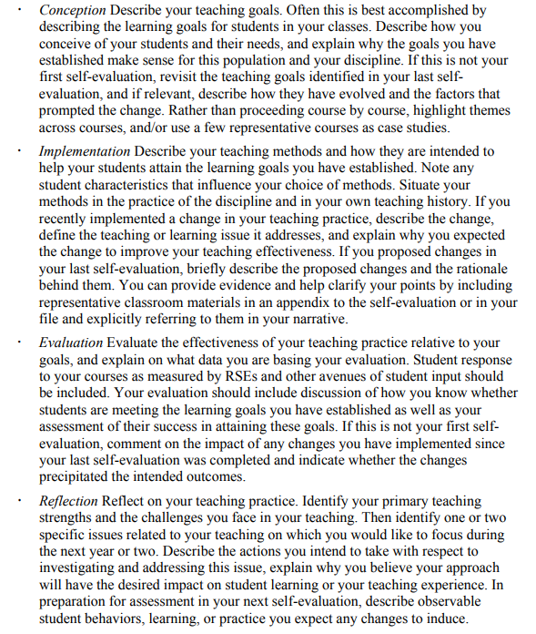
https://docplayer.net/13115383-Structuring-self-evaluations-prepared-by-richard-a-holmgren-allegheny-college.html

Slide 10
Let’s ask the students!
On second thought…..

Slide 11
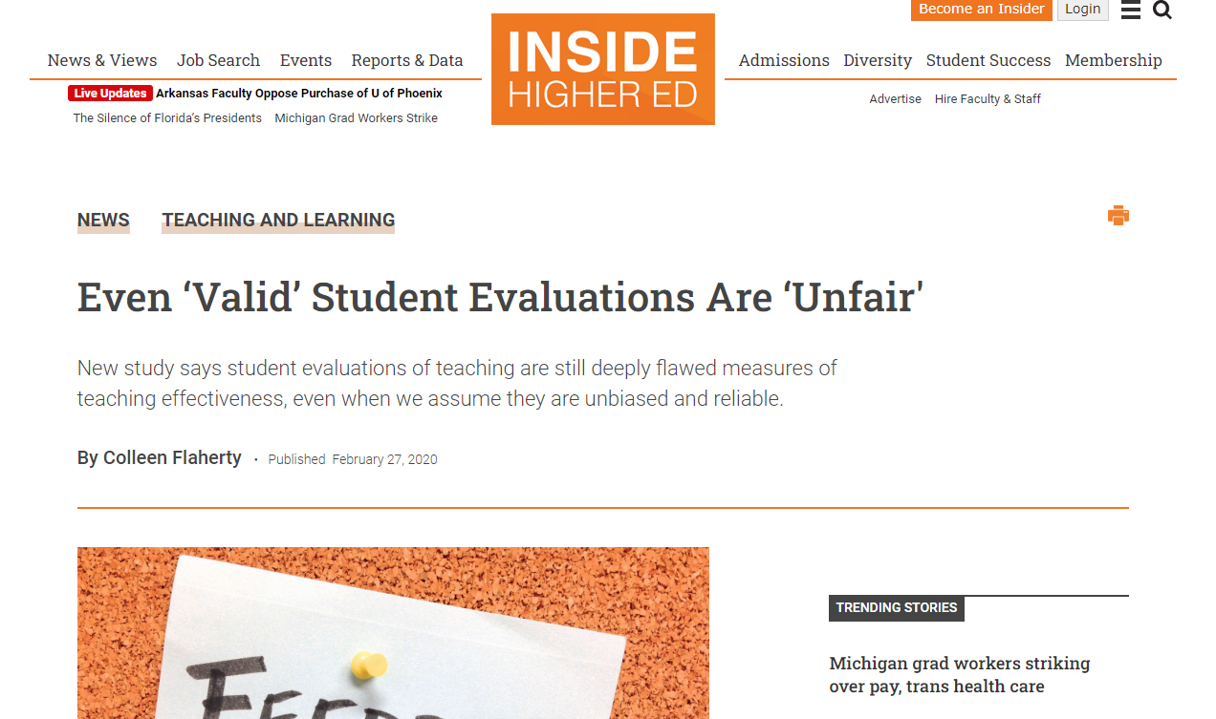
https://www.insidehighered.com/news/2020/02/27/study-student-evaluations-teaching-are-deeply-flawed

Slide 12
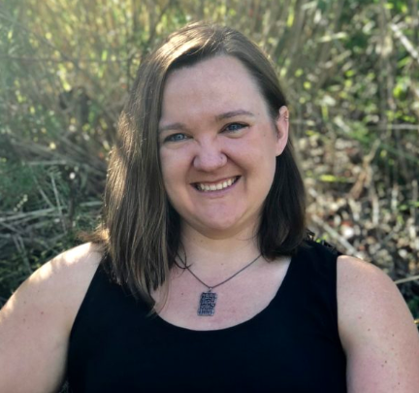
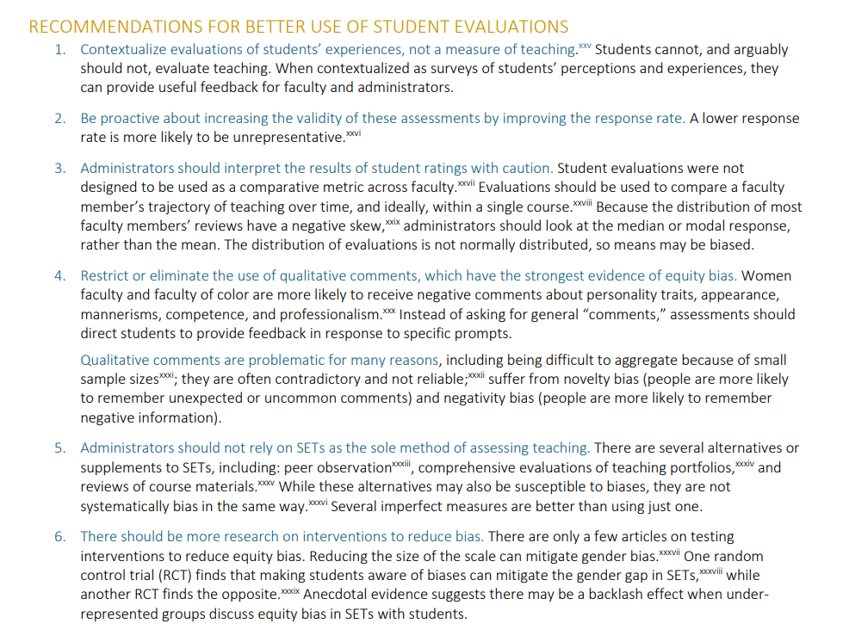
EVIDENCE OF MEASUREMENT AND EQUITY BIAS IN STANDARD EVALUATIONS OF TEACHING
Rebecca J. Kreitzer
Associate Professor
of Public Policy
University of North Carolina
at Chapel Hill
https://www.rebeccakreitzer.com/bias/

Slide 13







EVIDENCE OF MEASUREMENT AND EQUITY BIAS IN STANDARD EVALUATIONS OF TEACHING
Rebecca J. Kreitzer
Associate Professor
of Public Policy
University of North Carolina
at Chapel Hill
https://www.rebeccakreitzer.com/bias/

Slide 14
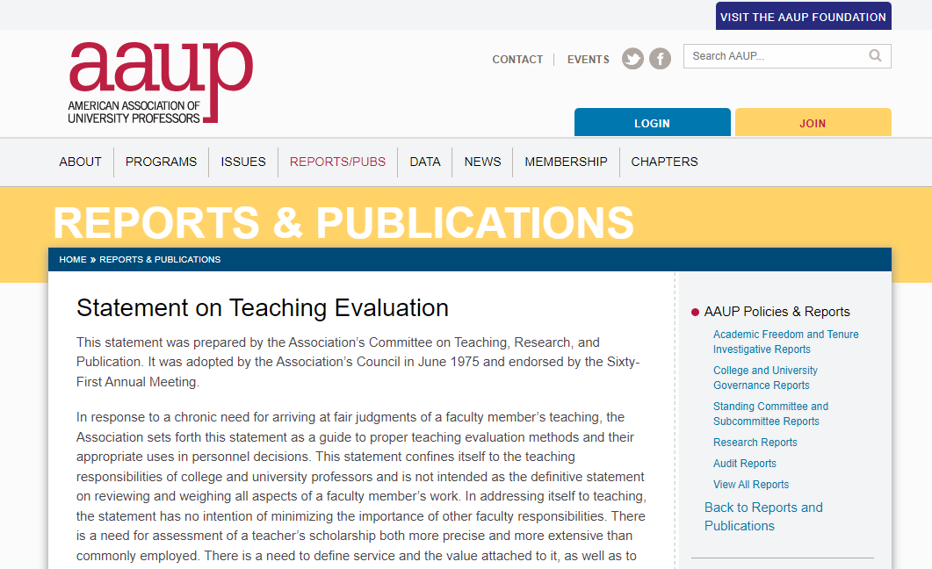
https://www.aaup.org/report/statement-teaching-evaluation

Slide 15
“An important and often overlooked element of evaluating teaching is an accurate description of a professor’s teaching.
Such a description should include the number and level and kinds of classes taught, the numbers of students, and out­-of-­class activities related to teaching. Such data should be very carefully considered both to guard against drawing unwarranted conclusions and to increase the possibilities of fairly comparing workloads and kinds of teaching, of clarifying expectations, and of identifying particu­lars of minimum and maximum performance.”
https://www.aaup.org/report/statement-teaching-evaluation

Slide 16
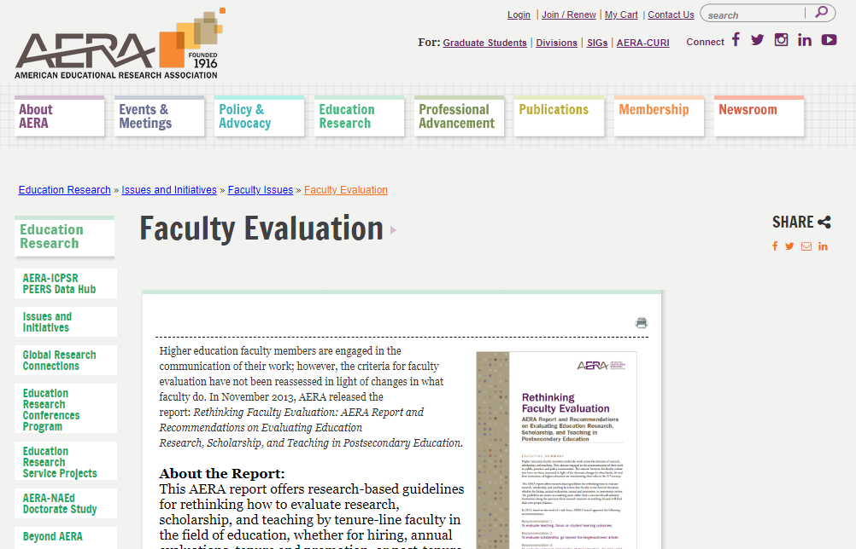
https://www.aera.net/Education-Research/Issues-and-Initiatives/Faculty-Issues/Faculty-Evaluation

Slide 17
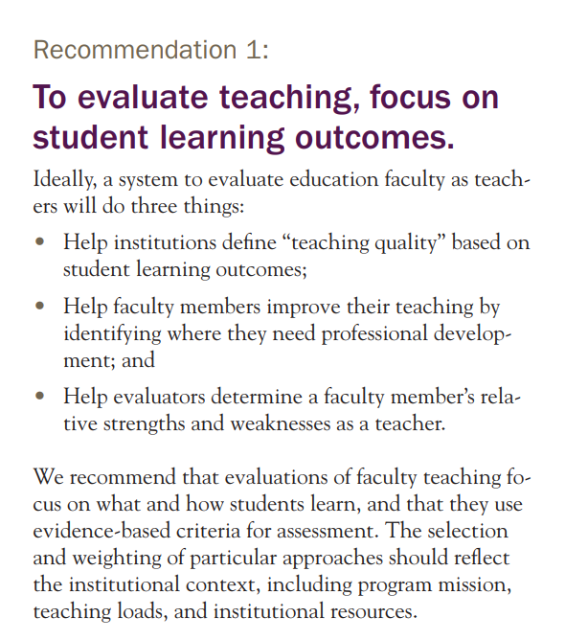
https://www.aera.net/Education-Research/Issues-and-Initiatives/Faculty-Issues/Faculty-Evaluation

Slide 18

https://www.nationalacademies.org/our-work/recognition-and-evaluation-of-teaching-in-higher-education-a-workshop

Slide 19
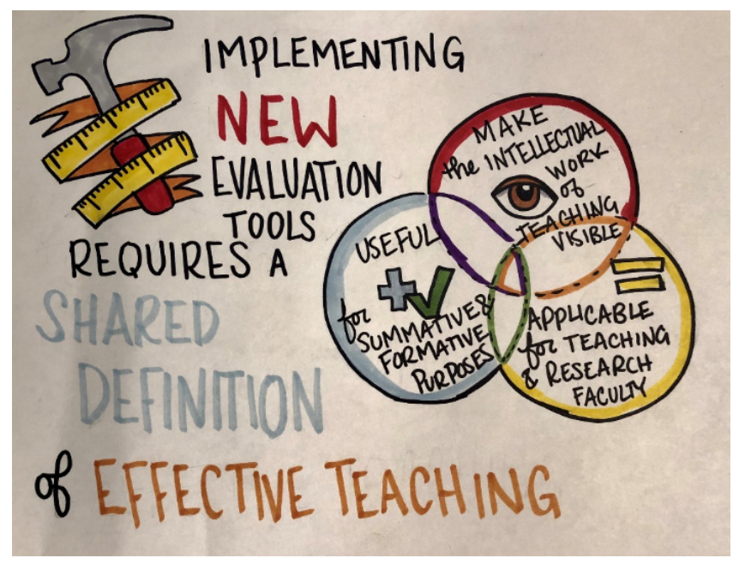
https://www.nationalacademies.org/our-work/recognition-and-evaluation-of-teaching-in-higher-education-a-workshop

Slide 20

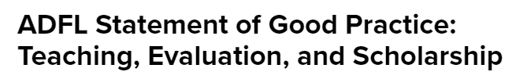
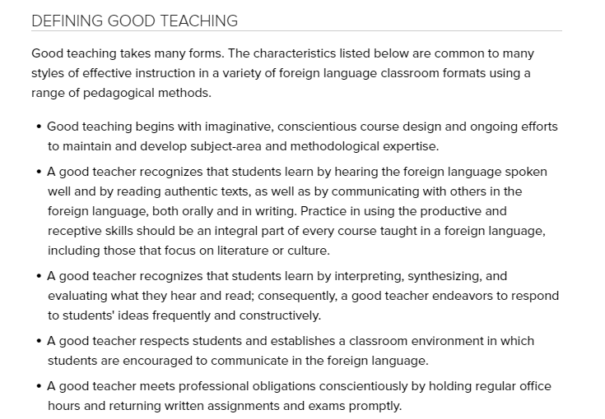
https://www.maps.mla.org/Resources/Policy-Statements/ADFL-Statement-of-Good-Practice-Teaching-Evaluation-and-Scholarship
https://www.maps.mla.org/Resources/Policy-Statements/ADE-Statement-of-Good-Practice-Teaching-Evaluation-and-Scholarship

Slide 21
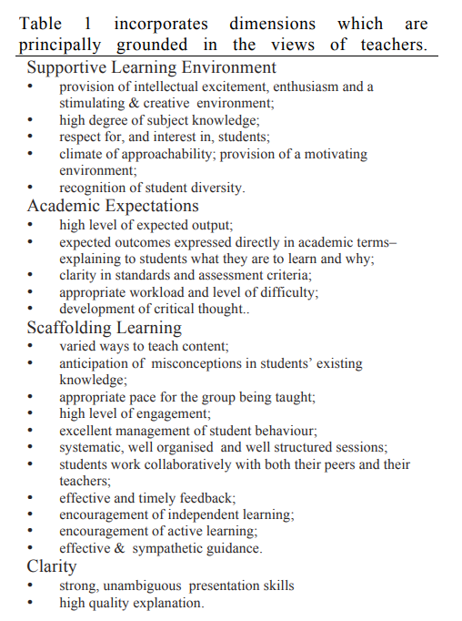
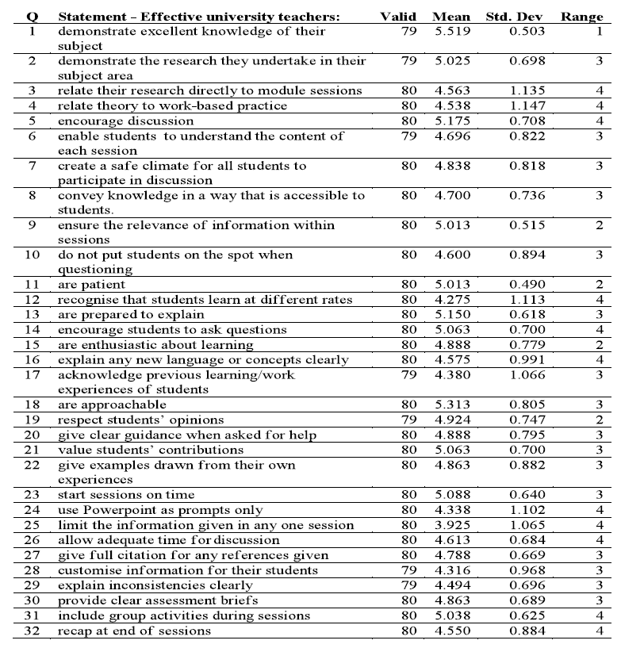
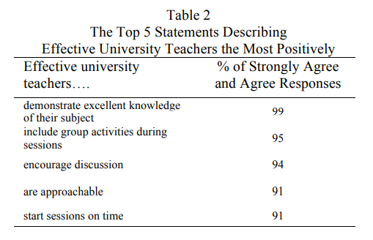
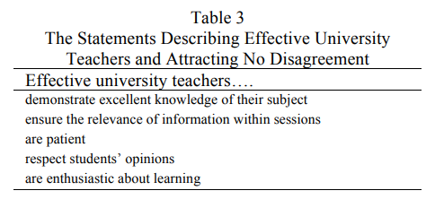
Effective Teaching in Higher Education:
Perceptions of First Year Undergraduate Students
Jo Allan, Karen Clarke, and Michael Jopling
International Journal of Teaching and Learning in Higher Education
2009, Volume 21 Number 3, 362-372
https://files.eric.ed.gov/fulltext/EJ909070.pdf

Slide 22
Do we know what “good” teaching is now?

Slide 23
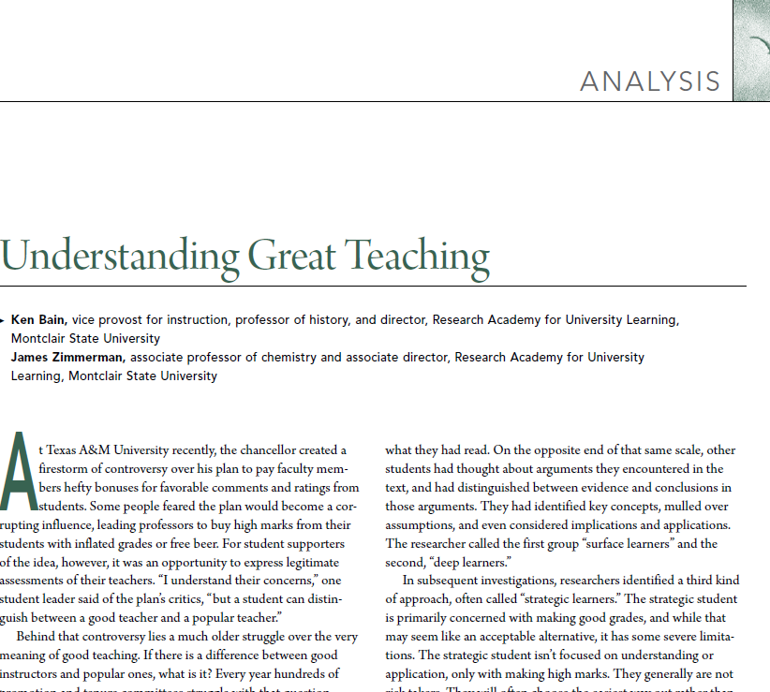
One summary from
Peer Review
“Here’s a summary of what our great
teachers told us: Human beings are most
likely to learn deeply when they are trying
to solve problems or answer questions that
they have come to regard as important,
intriguing, or beautiful. This is their
description of what we call the Natural
Critical Learning Environment”
Good Teaching: What Is It and How Do We Measure It?
Spring 2009 (Vol. 11, No. 2)

Slide 24
Nationally Recognized quality rubrics
Blackboard Exemplar Course Rubric (BB)
Open SUNY Course Quality Review (OSCQR)
Quality Course Teaching and Instructional Practice (QCTIP)
Quality Matters Higher Education course Rubric (QM)
Higher Ed. Standards (link on right)

Slide 25
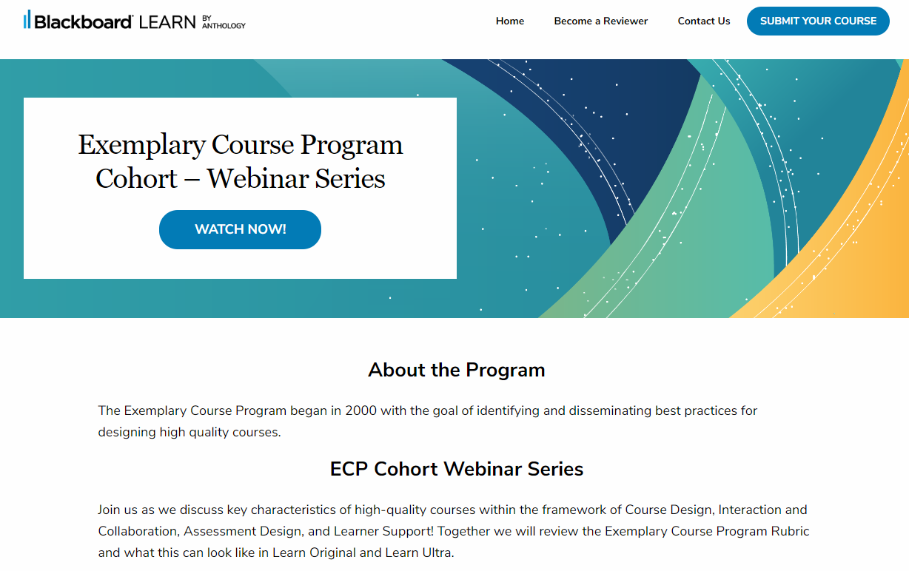
Blackboard Exemplar Course Rubric (BB)

Slide 26
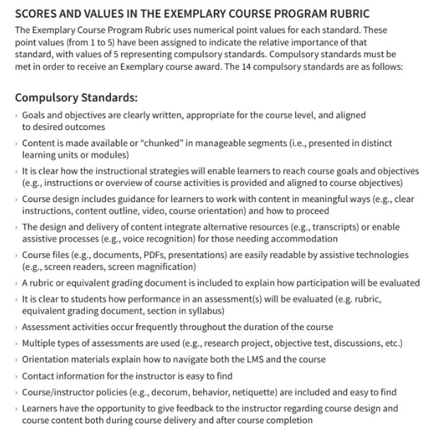
Blackboard Exemplar Course Rubric (BB)
https://community.anthology.com/groups/blogpost/view/32/17/890

Slide 27
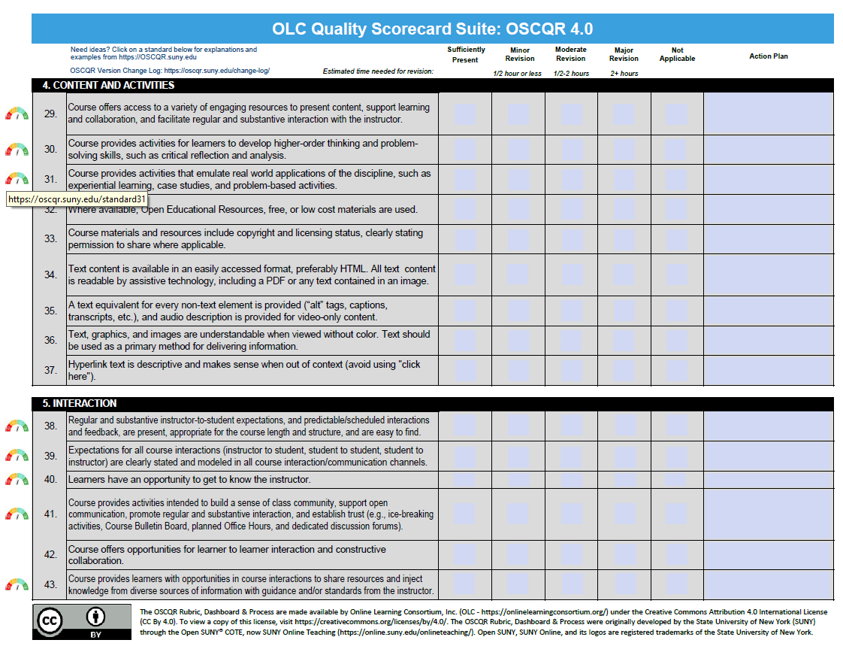
Open SUNY Course Quality Review (OSCQR)

Slide 28
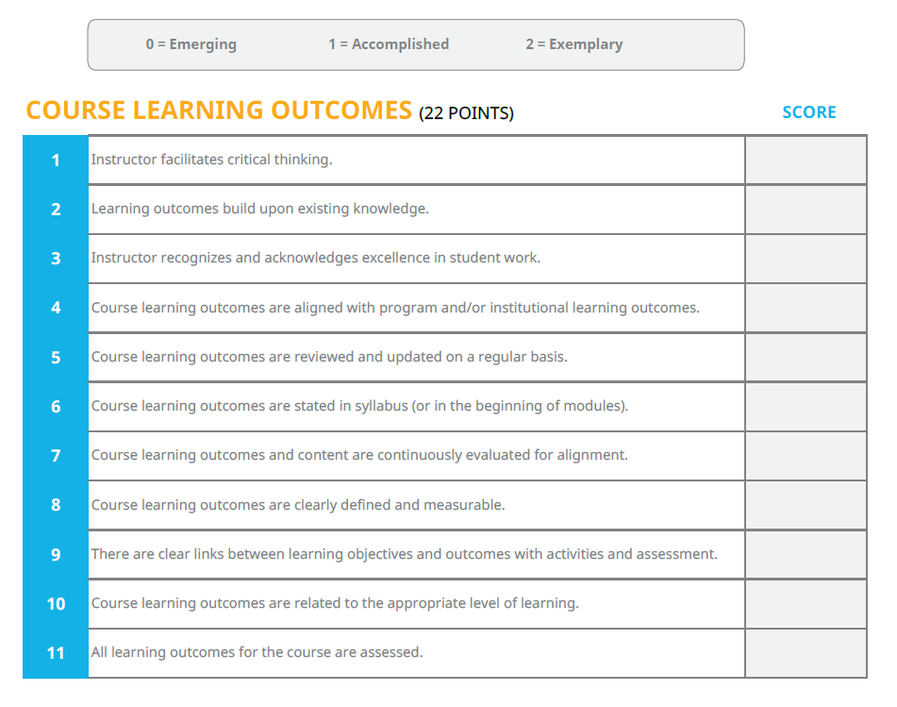
Quality Course Teaching and Instructional Practice (QCTIP)

Slide 29
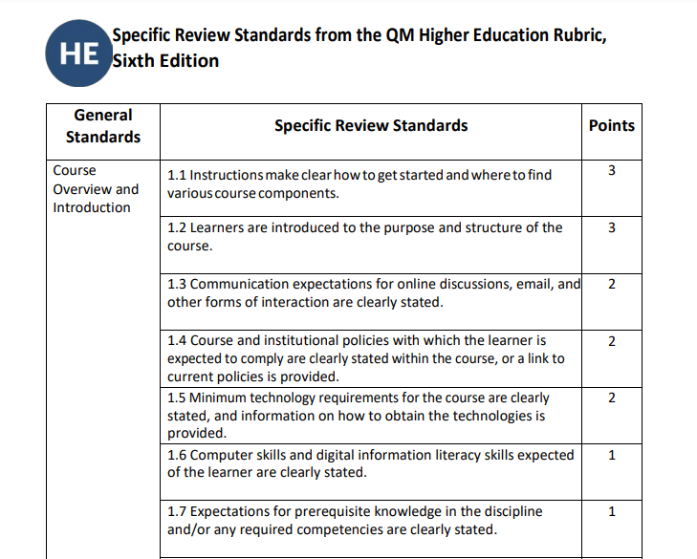
Quality Matters Higher Education course Rubric (QM)

Slide 30

What do these quality rubrics all have in common?

Slide 31
Quality standards all have these in common:
Effective course design – with well stated course objectives and activities that support the learning objectives that help them struggle through BBQ’s (Big Beautiful Questions)
Frequent Interaction with professor and class collaboration activities and exercises
A mix of high and low stakes assessments that allow the student to know how well they are doing throughout the course
Frequent and easy access to the instructor and a menu of campus support services

Slide 32
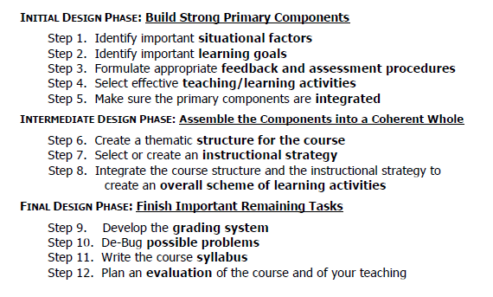
Quality standards all have these in common:
https://www.deefinkandassociates.com/GuidetoCourseDesignAug05.pdf

Slide 33
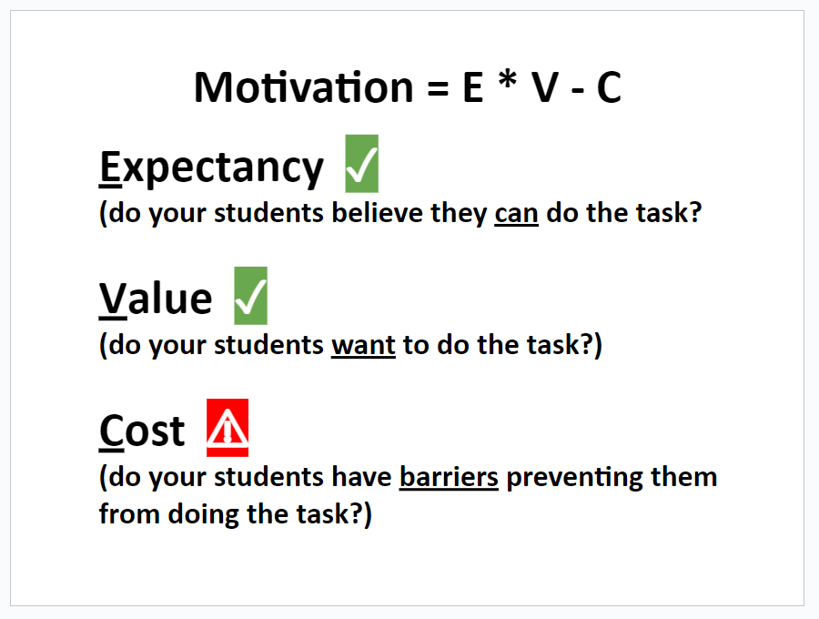
Students also have to be motivated
(sample E*V-C model) motivation theory
Kenneth E. Barron
James Madison University
Chris Hulleman
University of Virginia
Steve Getty
Colorado College
Joseph A Taylor
University of Colorado Colorado Springs
Instructors guide for the Expectancy Value Cost Survey of Student Motivation

Slide 34
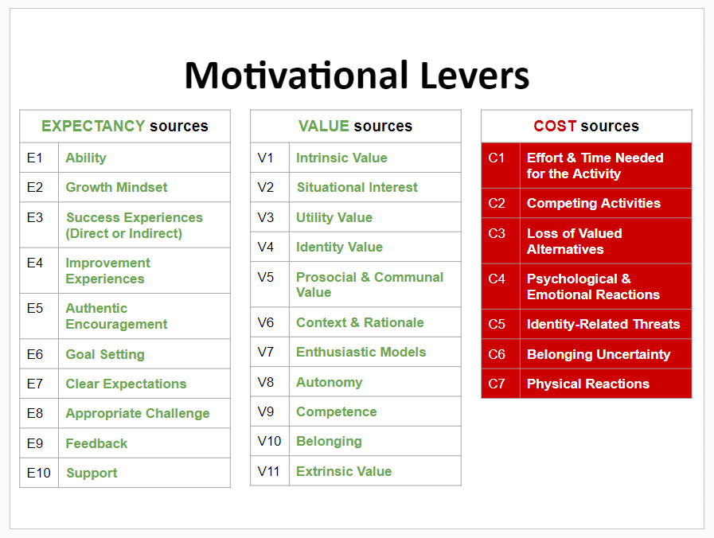
Motivation = E * V-C
Barron, K.E., & Hulleman, C.S. (2006). Is there a formula to help understand and improve student motivation? https://teachpsych.org/ebooks/eit2006/index.php/

Slide 35
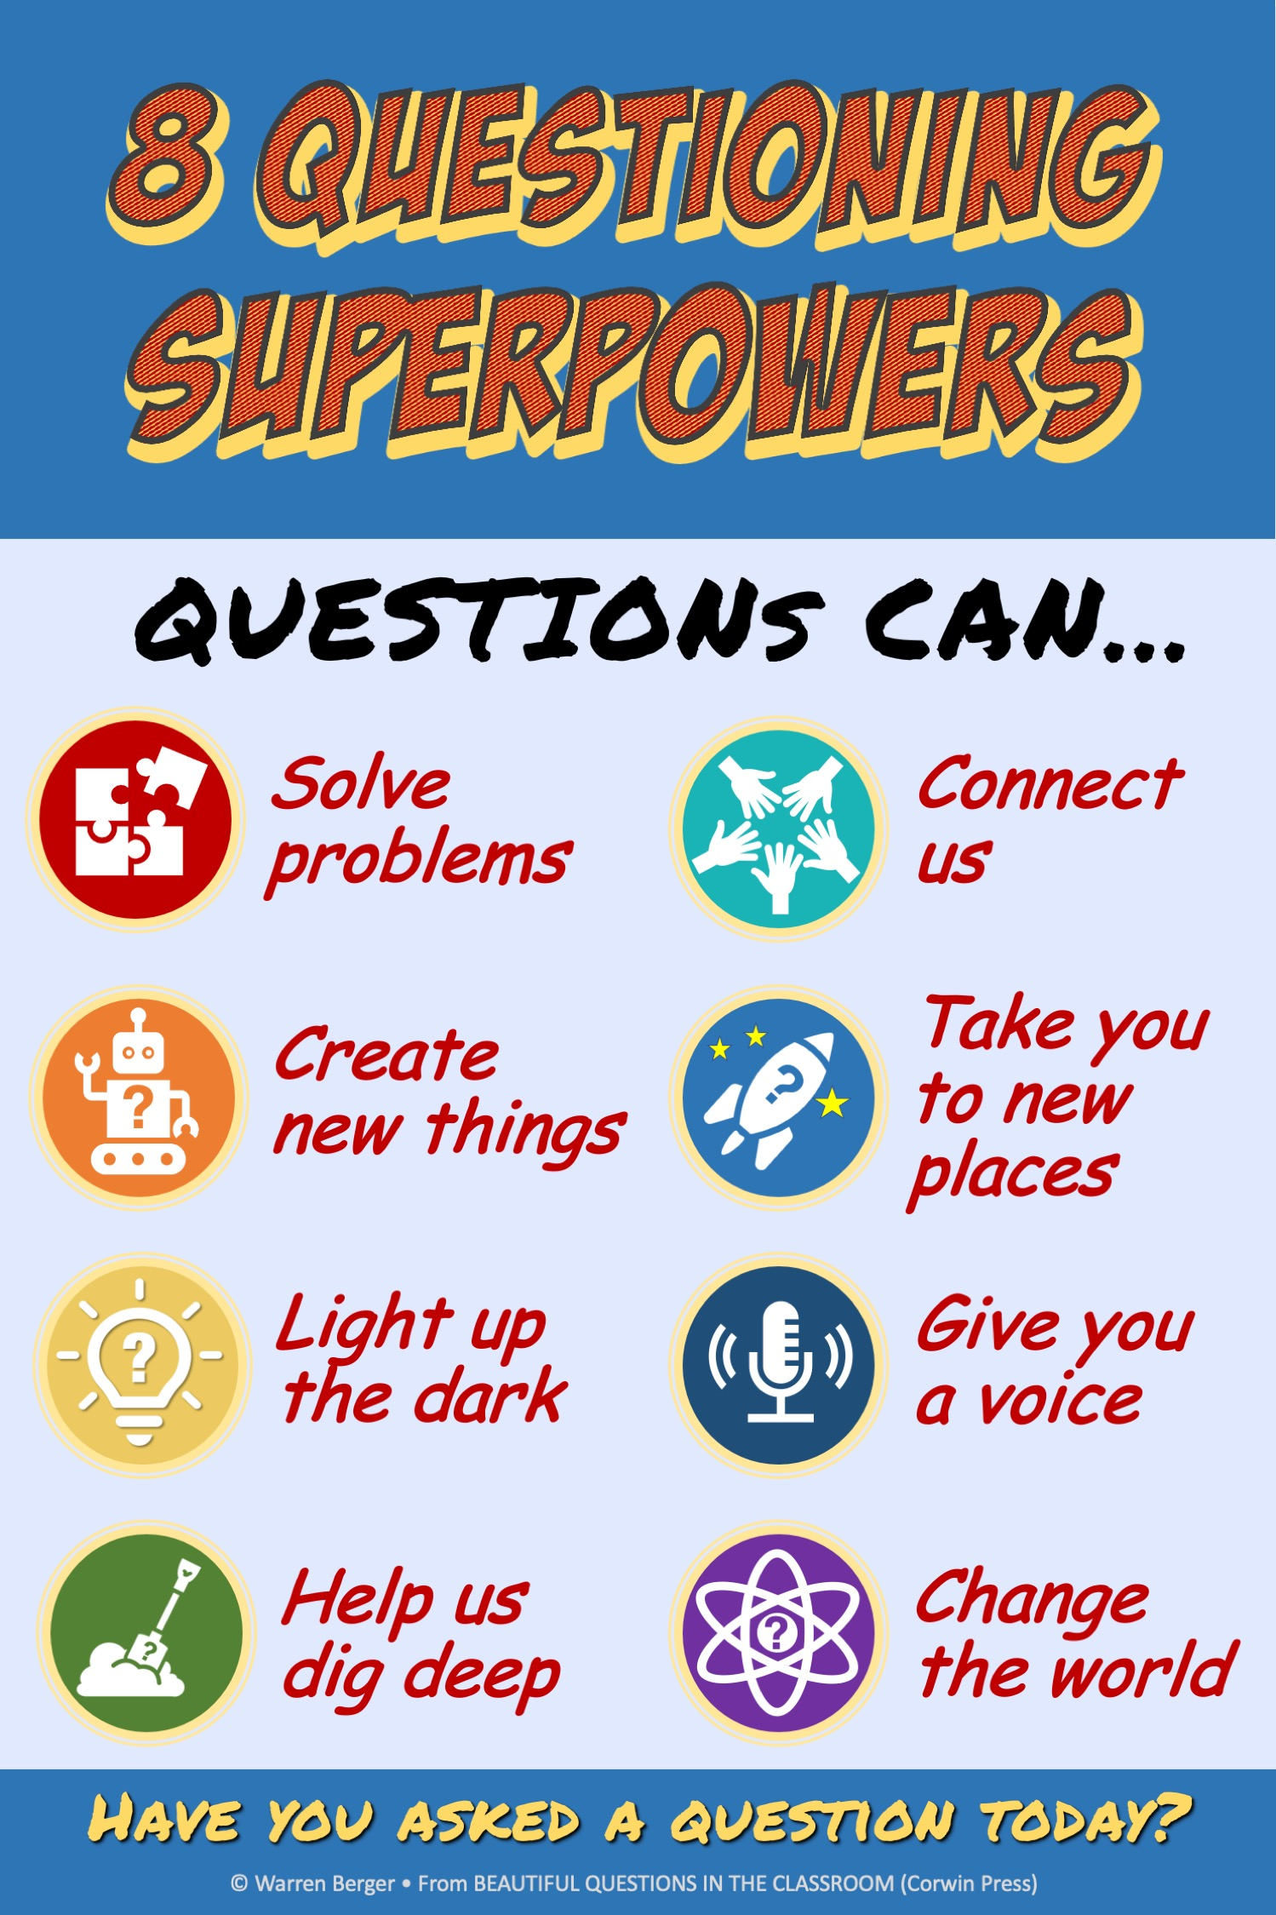
Asking “BBQ” Questions is key to student engagement and interaction. Getting them engaged in finding out the answers even more so.
https://us.corwin.com/books/ambq-263079

Slide 36
University of British Columbia
Math and Sciences Teaching Practices Inventory
The Teaching Practices Inventory: A New Tool for Characterizing College and University Teaching in Mathematics and Science,. https://doi.org/10.1187/cbe.14-02-0023.
The Teaching Practices Inventory (formerly called the "Teaching Practices Survey") was designed to characterize the teaching practices used in undergraduate science and mathematics courses. The inventory requires 10-15 minutes to fill out and provides a detailed characterization of practices used in all aspects of a "lecture" course (it is not suitable for use with courses that are primarily laboratories, seminars, or project courses). It was tested with several hundred faculty members at UBC and refined over a 6-year period.
https://cwsei.ubc.ca/resources/tools/tpi

Slide 37
Teaching Perspectives Inventory
http://www.teachingperspectives.com/tpi/
a 45-item inventory that can be used to determine your teaching orientation. This inventory can be a helpful tool for reflection and improvement of teaching. It can also help you prepare to write or revise a statement of teaching philosophy.

Slide 38
Other self-evaluation checklists and rubrics
Instructor Self-Evaluation, created by Calvin College
Faculty Teaching Self-Assessment form, created by Central Piedmont Community College
Instructor/Course Self Rating Form, created by Saint Mary’s University
Faculty Self-Evaluation of Teaching, created by the University of Dayton (self-evaluation rubrics, narrative self-evaluation forms, reflective questions)

Slide 39
What additional ideas and observations do you have to share?

Slide 40
List of resources in this presentation:
https://dgmg81phhvh63.cloudfront.net/content/user-photos/Publications/Archives/Peer-Review/PR_SP09_Vol11No2.pdf Good Teaching: What Is It and How Do We Measure It? Peer Review, Spring 2009 (Vol. 11, No. 2)
https://docplayer.net/13115383-Structuring-self-evaluations-prepared-by-richard-a-holmgren-allegheny-college.html
https://www.insidehighered.com/news/2020/02/27/study-student-evaluations-teaching-are-deeply-flawed
https://www.rebeccakreitzer.com/bias/
https://www.aaup.org/report/statement-teaching-evaluation
https://www.aera.net/Education-Research/Issues-and-Initiatives/Faculty-Issues/Faculty-Evaluation
https://www.nationalacademies.org/our-work/recognition-and-evaluation-of-teaching-in-higher-education-a-workshop
https://www.maps.mla.org/Resources/Policy-Statements/ADE-Statement-of-Good-Practice-Teaching-Evaluation-and-Scholarship
https://files.eric.ed.gov/fulltext/EJ909070.pdf Effective Teaching in Higher Education: Perceptions of 1st yr Undergraduate Students
https://www.deefinkandassociates.com/GuidetoCourseDesignAug05.pdf

Slide 41
Resources continued:
Blackboard Exemplar Course Rubric (BB)
Open SUNY Course Quality Review (OSCQR)
Quality Course Teaching and Instructional Practice (QCTIP)
Quality Matters Higher Education course Rubric (QM)
Higher Ed. Standards (link on right)
https://www.researchgate.net/publication/319433479_User%27s_Guide_for_the_Expectancy-Value-Cost_Survey_of_Student_Motivation
Barron, K.E., & Hulleman, C.S. (2006). Is there a formula to help understand and improve student motivation? https://teachpsych.org/ebooks/eit2006/index.php/
https://commons.lib.jmu.edu/cgi/viewcontent.cgi?article=1221&context=master201019 Measuring cost: The forgotten component of expectancy value theory
https://drive.google.com/file/d/1P4YXNxUO9TZUEDzXR3W4pQxtT--KHjNG/view?usp=sharing EVC Formula and Sources Handout
https://us.corwin.com/books/ambq-263079 Beautiful Questions in the Classroom
The Teaching Practices Inventory: A New Tool for Characterizing College and University Teaching in Mathematics and Science

Slide 42
Resources continued:
http://www.teachingperspectives.com/tpi/
Instructor Self-Evaluation, created by Calvin College
Faculty Teaching Self-Assessment form, created by Central Piedmont Community College
Instructor/Course Self Rating Form, created by Saint Mary’s University
Faculty Self-Evaluation of Teaching, University of Dayton, contains self-evaluation rubrics, a narrative self-evaluation form, and several series of reflective questions.

